Slide 1
Core Data or SQLite
Data management in iOS programming

Slide 2
Summary
Differences between Core Data and SQLite
Primary use of a DataBase
Primary use of an Object Graph
What Core Data can do
What Core Data can’t do
When to use SQLite?
When to use Core Data?
Benefits of using Core Data
Examples of queries and CoreData similar use
References
Questions

Slide 3
1 Differences between Core Data and SQLite
SQLite is a database
Core Data is an object graph and persistence manager
Core Data can store objects into XML, SQLite, atomic or in-memory
There are things that SQLite can do, but not Core Data. Example: Unique ids
And viceversa. Example: See the relationships of an object

Slide 4
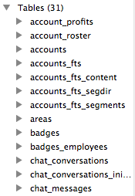
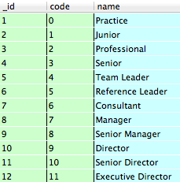
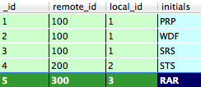
2 Primary use of a DataBase
Persistant storage
Fetching and updating capabilities

Slide 5
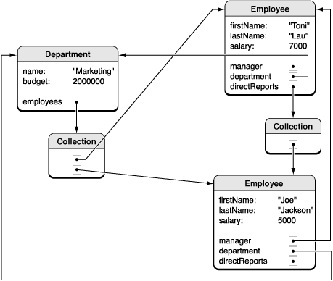
3 Primary use of an Object Graph
View the instances of a system and their relationships at a particular point in time

Slide 6
4 What Core Data can do
Retrieve and manipulate data without worrying about the details of storage or retrieval
When you connect 2 objects they are perpetually in sync
Connected objects can exist out of memory (faulted) until they are needed
Deletion of objects can trigger cascading deletion
Can be used totally in-memory
It’s possible to use Core Data without any form of searching if your objects are all connected
Properties are implemented by methods and they are observables and overrideables

Slide 7
5 What Core Data can’t do
Core Data must load the data into memory to operate, even to delete an object
Core Data doesn’t handle data logic, it’s responsibility of the business logic. Example: unique ids in SQL
Doesn’t support multiple threading access

Slide 8
6 When to use SQLite?
The action where you delete a large number of objects it’s critical in your system
The action where you update with the same value a large number of objects it’s critical in your system. Example: mark all as read
You are going to port the code to other platforms

Slide 9
7 When to use Core Data?
The rest of the time, that is practically the 95% of the time

Slide 10



8 Benefits of using Core Data

Slide 11
8 Benefits of using Core Data
It saves a lot of code in the model component
High level of abstraction of your database
Better integration with the rest of the Cocoa API
It handles for you memory management
It handles versioning of your data model
KVO
iCloud file sync for free
Core Data graphical user interface editor

Slide 12
9 Examples of queries and CoreData similar use
Employee with initials ‘PR’
SELECT * FROM employees WHERE initials = ’PR’
[entity setName:@"Employee"];
[NSPredicate predicateWithFormat:@"initials == ‘PR’"];
Employees that have the account with id ‘MNS002’
SELECT employees.* FROM employees JOIN employees_accounts ON employees_accounts.employee_id = employees.initials WHERE account_id = ‘MNS002’
[entity setName:@"Employee"];
[NSPredicate predicateWithFormat:@"accounts.id CONTAINS ‘MNS002’"];

Slide 13
9 Examples of queries and CoreData similar use
Number of accounts where there is the employee with initials ‘PR’
SELECT COUNT (*) FROM employees_accounts WHERE employee_id = ‘PR’
[entity setName:@"Employee"];
[NSPredicate predicateWithFormat:@"initials == PR"];
employee.accounts.count;
[entity setName:@"Employee"];
[NSPredicate predicateWithFormat:@"initials == PR"];
NSExpression *keyExp = [NSExpression expressionForKeyPath:@"accounts.code"];
[NSExpression expressionForFunction:@"count:" arguments:@[keyExp]];

Slide 14
10 References
https://developer.apple.com/library/ios/documentation/Cocoa/Conceptual/CoreData/cdProgrammingGuide.html
http://www.cocoawithlove.com/2010/02/differences-between-core-data-and.html
http://stackoverflow.com/questions/840634/core-data-vs-sqlite-for-sql-experienced-developers
http://en.wikipedia.org/wiki/Core_Data
https://github.com/PabloRueda/CoreDataTutorials

Slide 15
11 Questions
?

